Slide 1

UR5 Robot Manipulator
Laura Calzoni
Jacopo Merlo Pich
Francesca Paradiso
Agatino Ricciardi

Slide 2
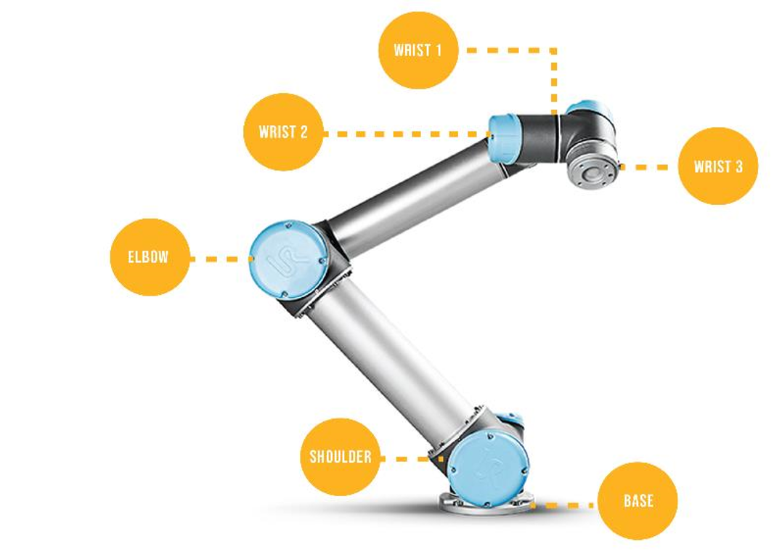
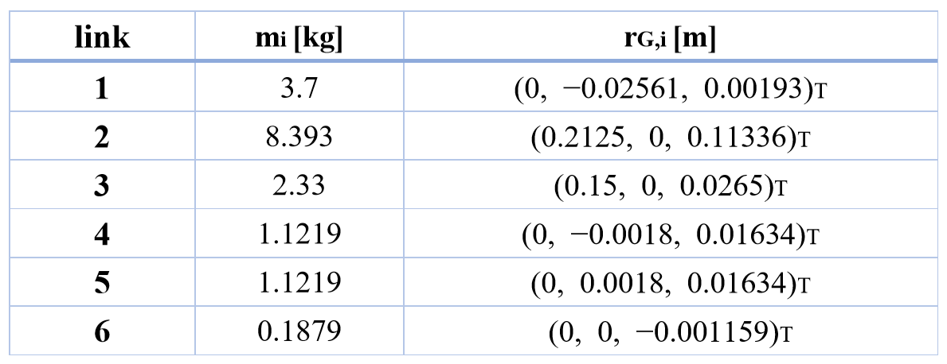
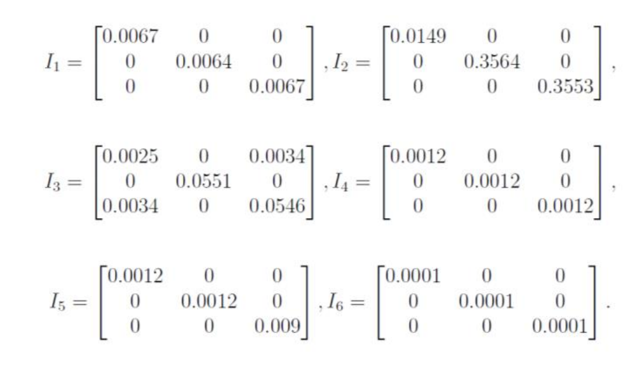
Implementation of the Kinematics
UR5 robotic arm

Slide 3
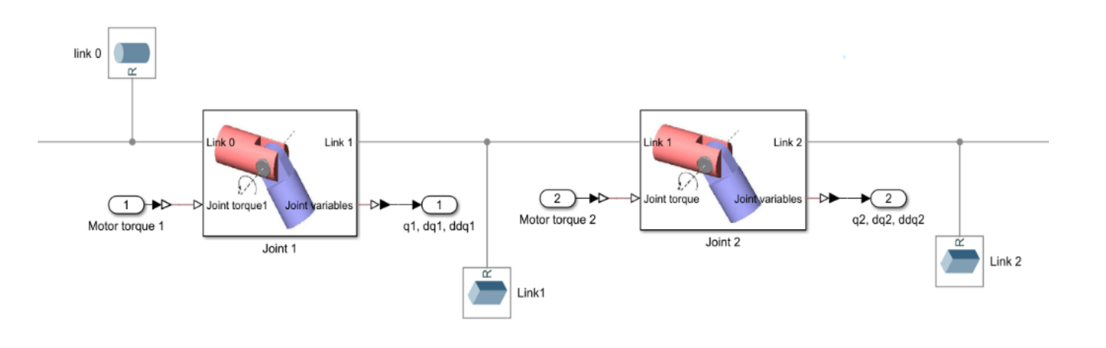
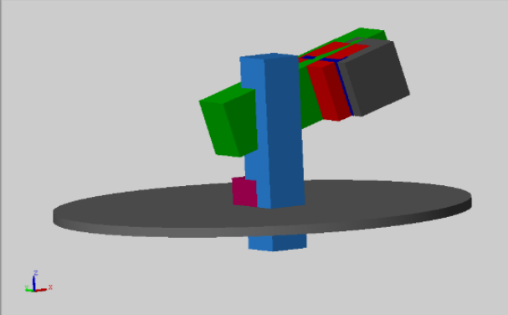
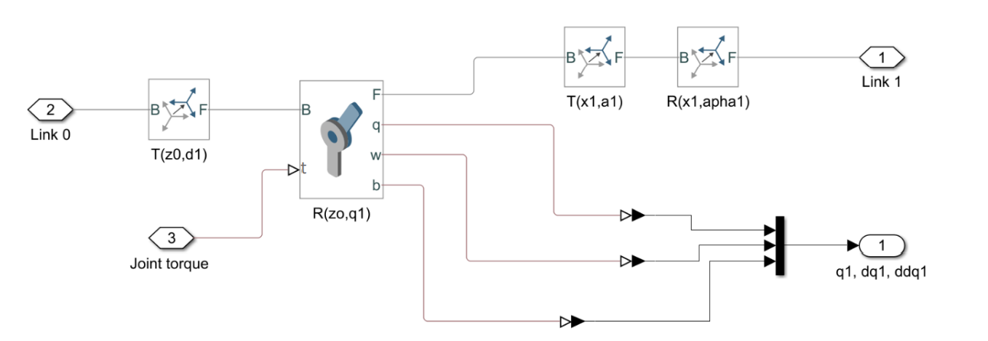
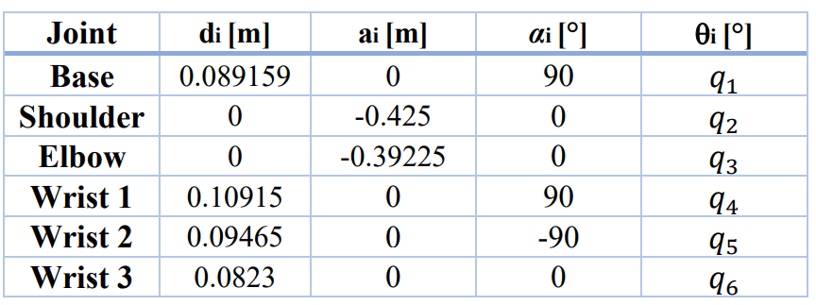
Implementation of the Kinematics

Slide 4
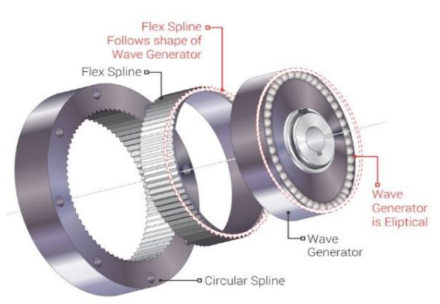
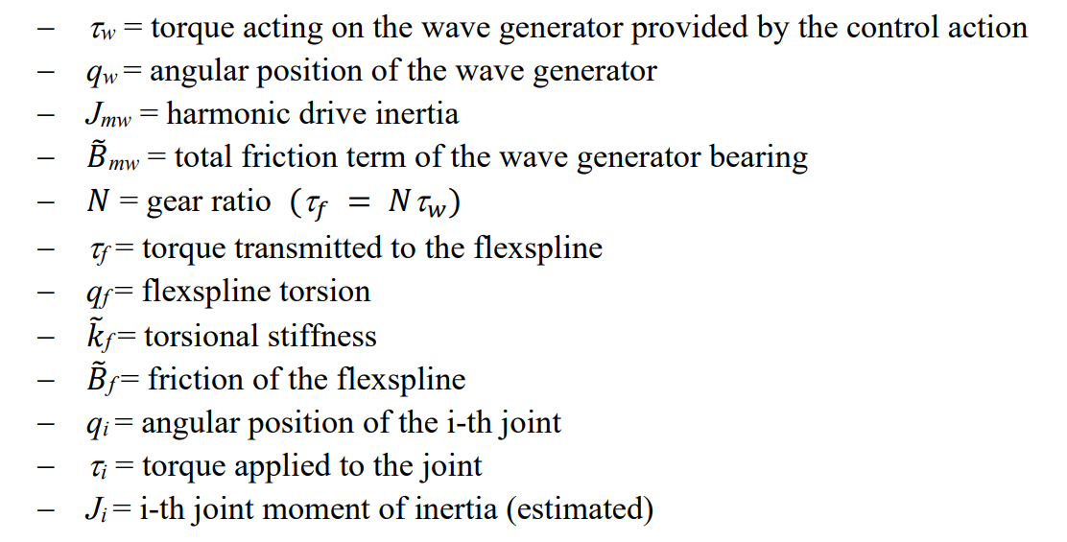
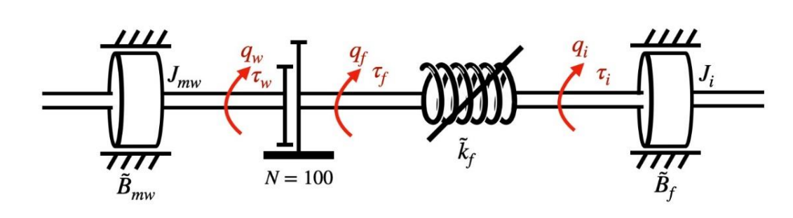
Harmonic Drive model

Slide 5
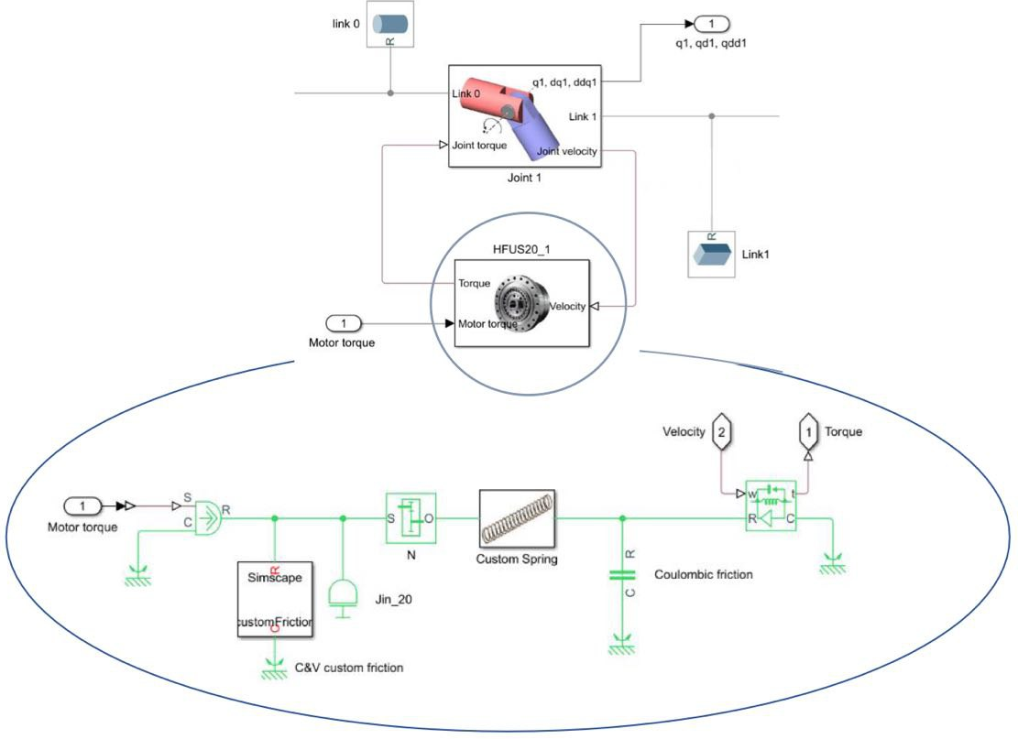
Harmonic Drive model

Slide 6
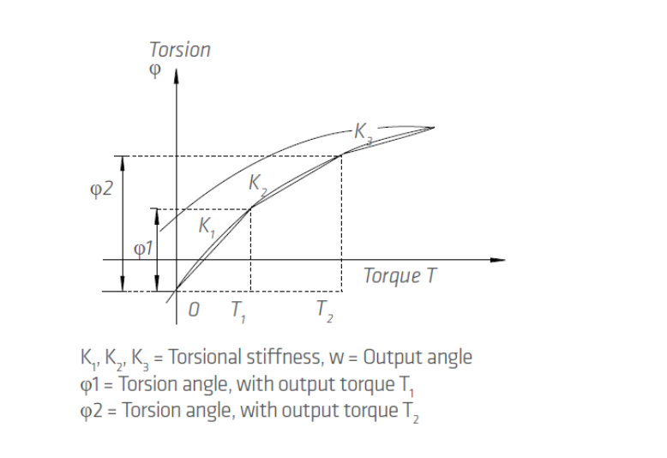
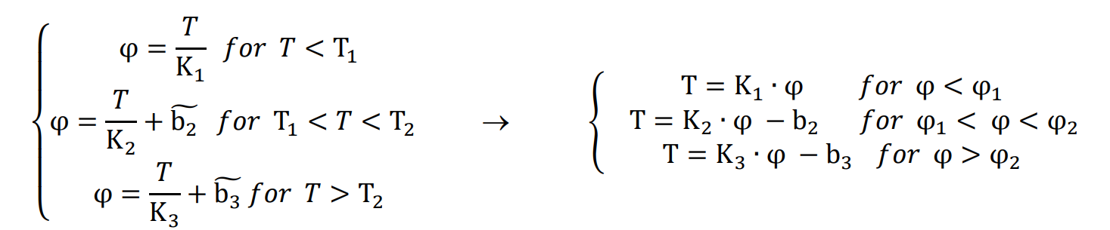
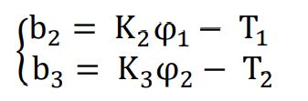
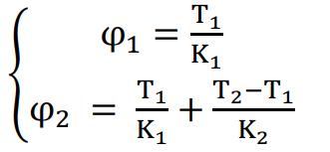
Harmonic Drive model - Torsional stiffness
 | Symbol | HFUS-14 | HFUS-20
Limit torque [N*m] | T1 | 2 | 7
 | T2 | 6,9 | 25
Torsional Stiffness [N*m/rad] | K3 | 7,1*10³ | 29*10³
 | K2 | 6,1*10³ | 25*10³
 | K1 | 4,7*10³ | 16*10³
Offsets [N*m] | b2 | 0,5957 | 3,9375
 | b3 | 1,8246 | 8,5675
With:

Slide 7
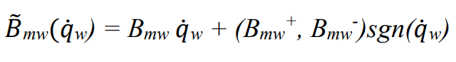
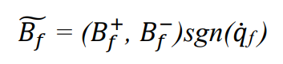
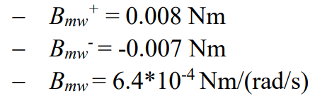
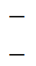
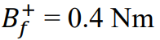
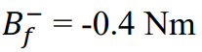
Harmonic Drive model - Friction model

Slide 8
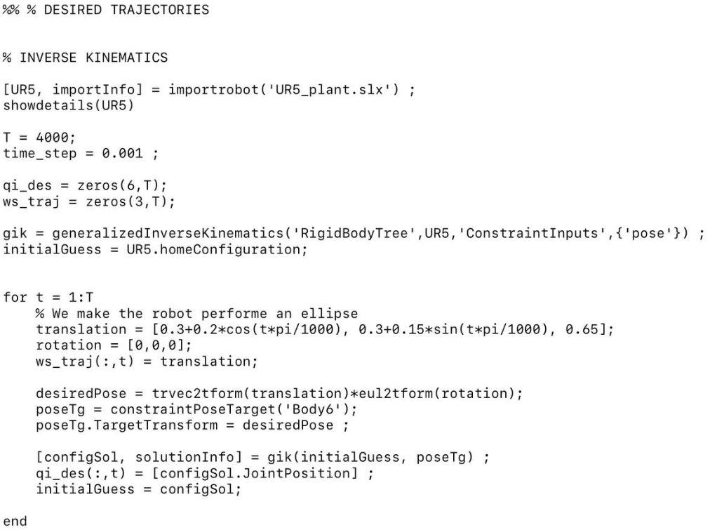
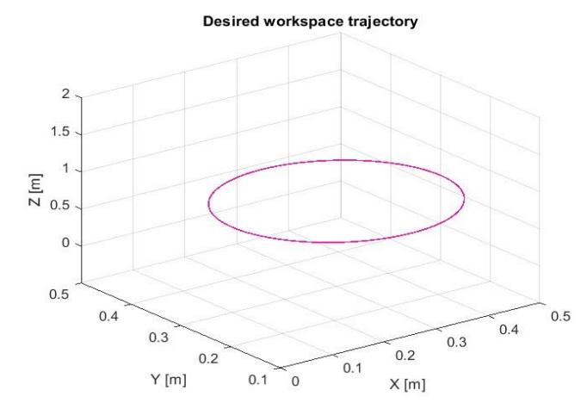
Inverse kinematics and definition of the desired trajectory

Slide 9
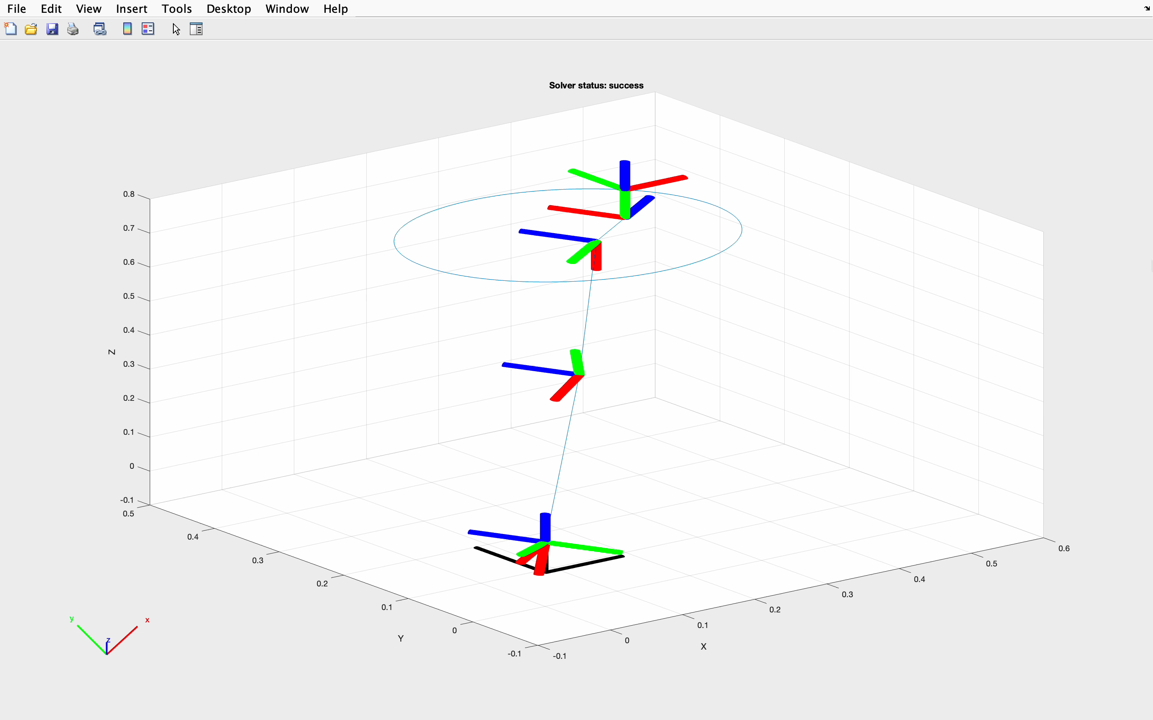
Inverse kinematics and definition of the desired trajectory

Slide 10
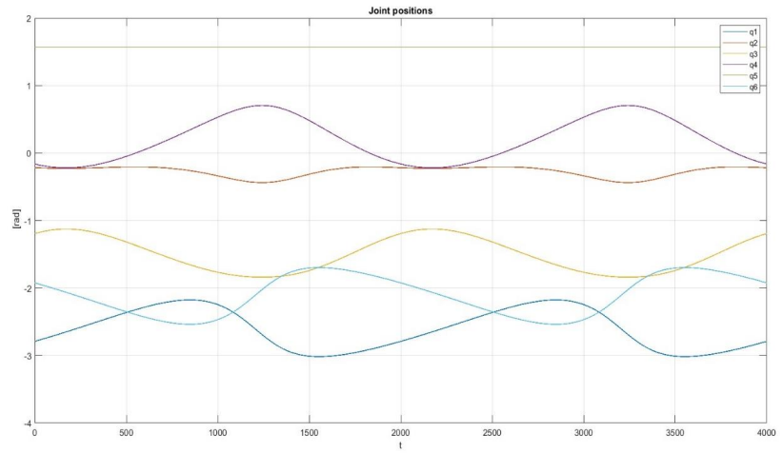
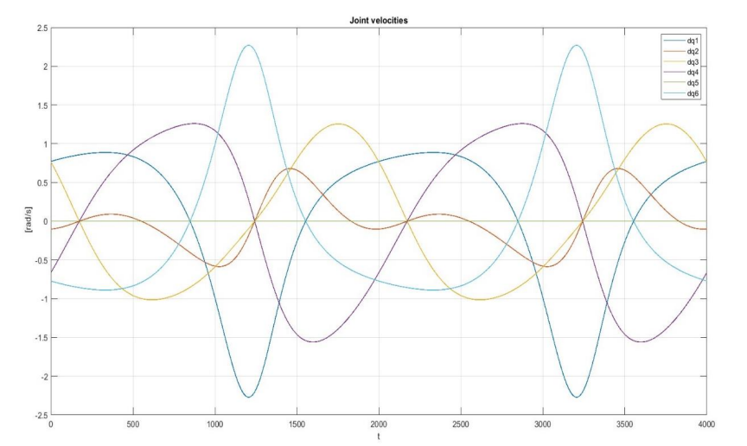
Inverse kinematics and definition of the desired trajectory
Desired joint positions
Desired joint velocities

Slide 11
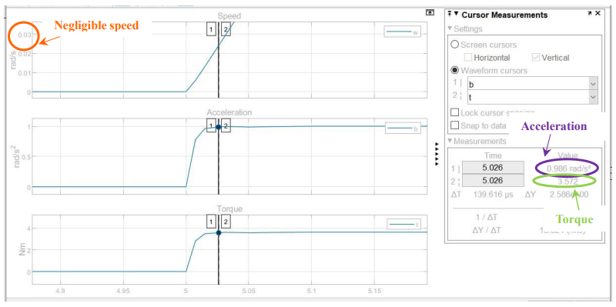
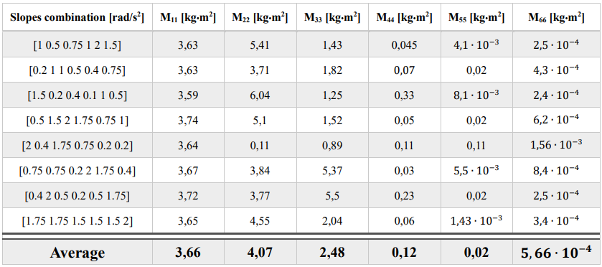
Estimation of the moments of inertia

Slide 12
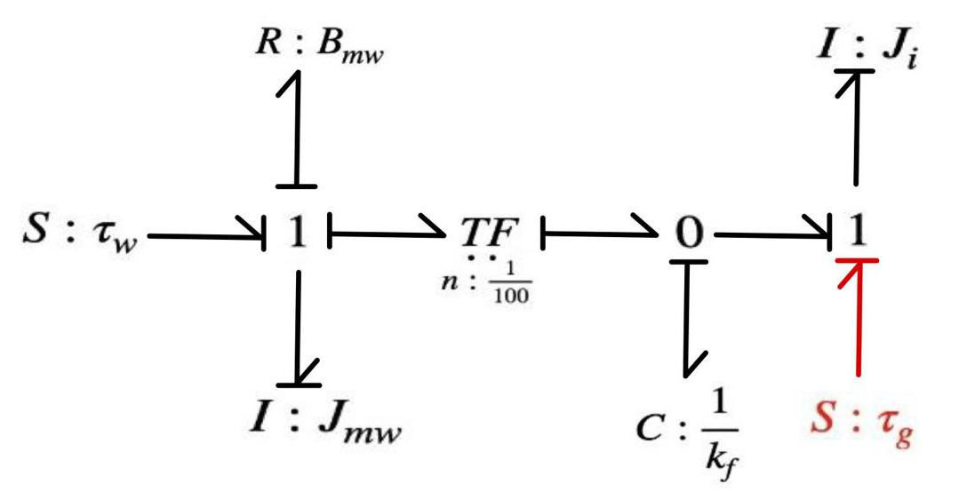
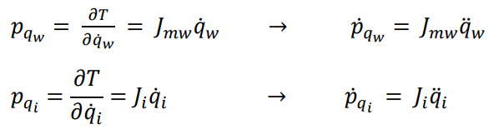
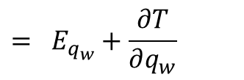
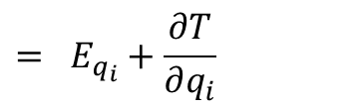
System equations
Lagrangian
approach:
$$= E_{q_{w}}+\frac{∂T}{∂q_{w}}$$
$$= E_{q_{i}}+\frac{∂T}{∂q_{i}}$$

Slide 13
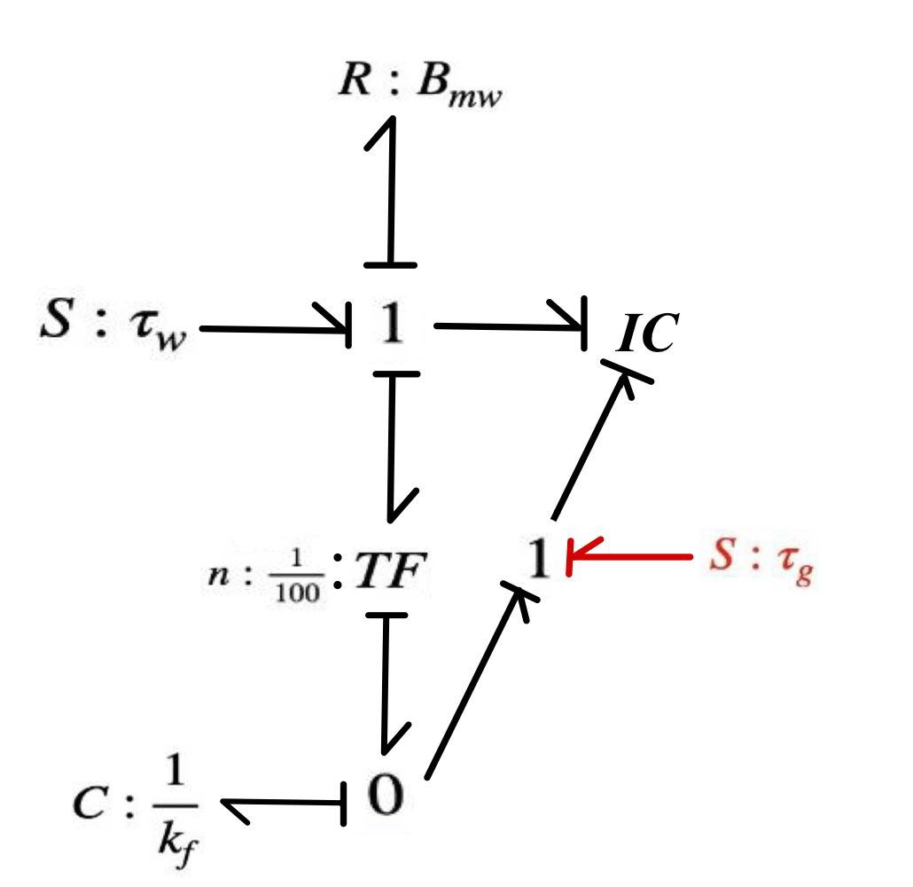
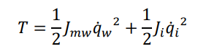
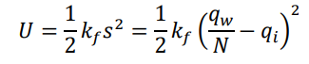
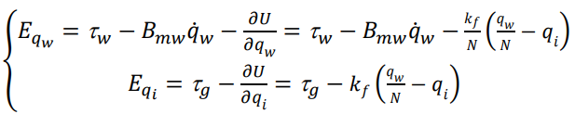
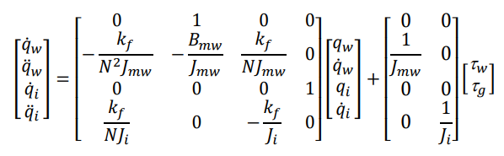
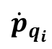

System equations
Kinetic and potential energy:
$${\dot{p}}_{q_{w}}$$
Generalized forces:
$${\dot{p}}_{q_{i}}$$
State space model:
A
x
B
u

Slide 14
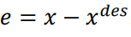
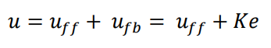
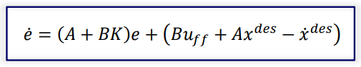
Decentralized position control
Control input: feedback and feedforward action
Error dynamics:

Slide 15
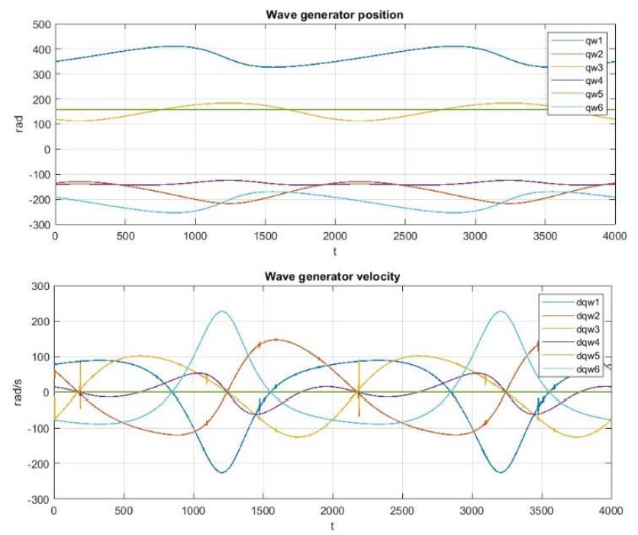
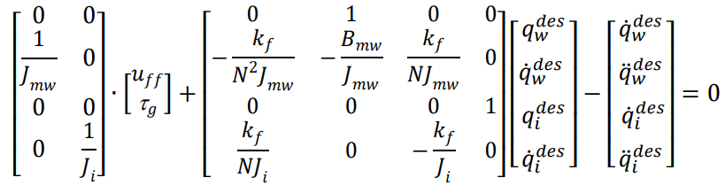
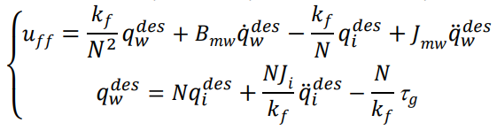
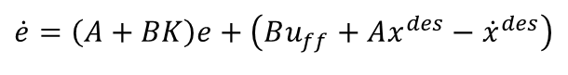
Decentralized position control - Feedforward action
$$\dot{e}=\left(A+BK\right)e+\left(Bu_{ff}+Ax^{des}−{\dot{x}}^{des}\right)$$
= 0

Slide 16
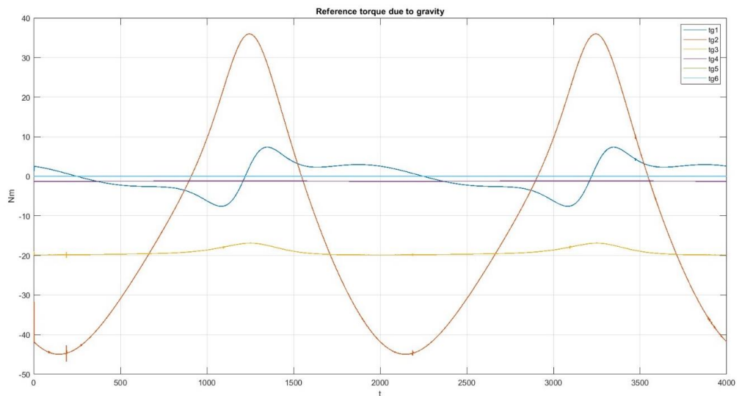
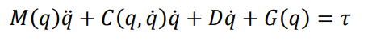
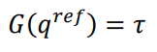
Decentralized position control – Compensation of the gravity term

Slide 17
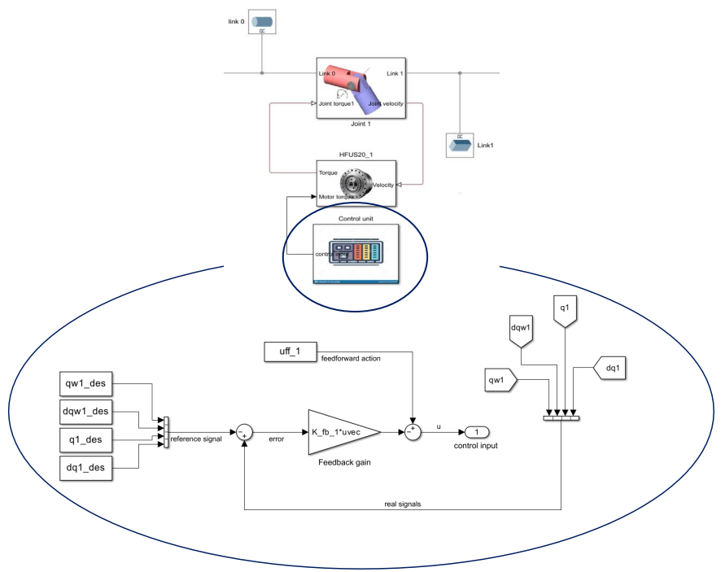
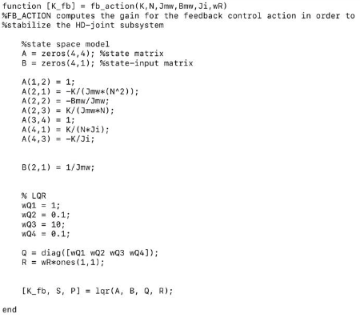
Decentralized position control – Feedback action

Slide 18

Results – Error in the joint space

Slide 19

Results – Error in the joint space

Slide 20


Results – Error in the workspace

Slide 21

Results – Error in the workspace

Slide 22

Results

